Slide 1
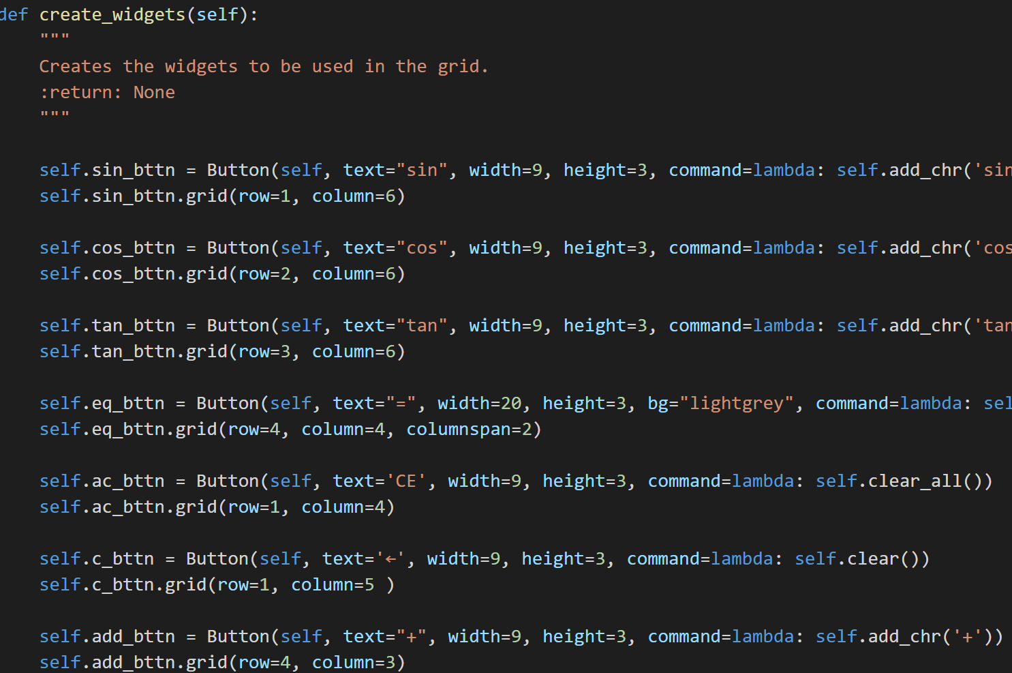
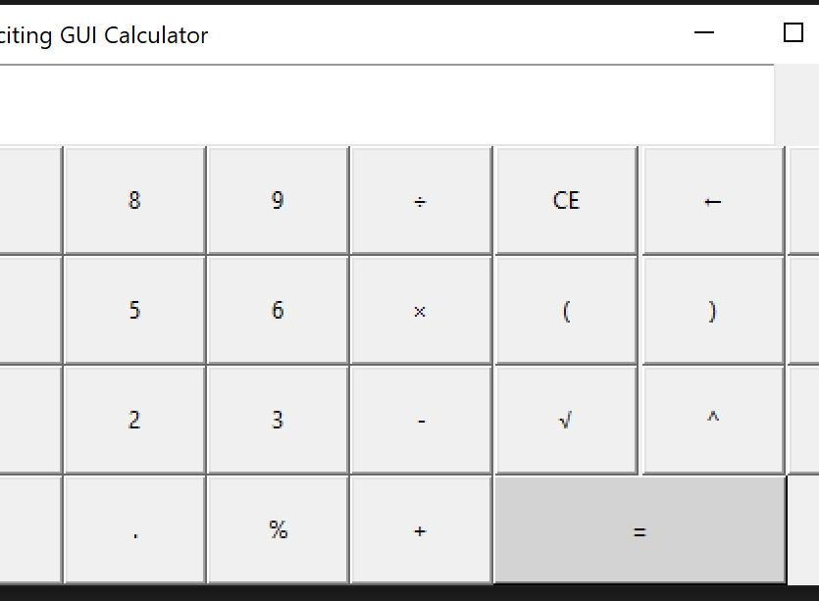
GUI Calculator
A fun app to modify a calculator using Tkinter
Coders: Brian Jones and Laquisha Adkins
https://github.com/ksu-is/GUI-Calculator

Slide 2

Our idea
The idea was created to use a graphical user interface calculator giving the user an option to customize buttons and colors
Personalized calculator

Slide 3
Source code & Tutorials
Researched two but the decision was to utilize one source code
Source code below:
https://github.com/dominict/pythonteachingcode/blob/master/3%20 calcGUI/CalcGUIModified.py
This link is the source code that was used to help generate the code for our project.

Slide 4
Project development
Initially, we had to fix errors in the calculator code.
We were receiving a command error such as some buttons not being operable. We referred to the source code and changed the error to allow it to run properly.
Next, we had issues of the code not running at all. We created an updated file and saved it as a Py.file to address the issue.
Finally, the code runs properly – buttons are able to be manipulated and colors are visible

Slide 5
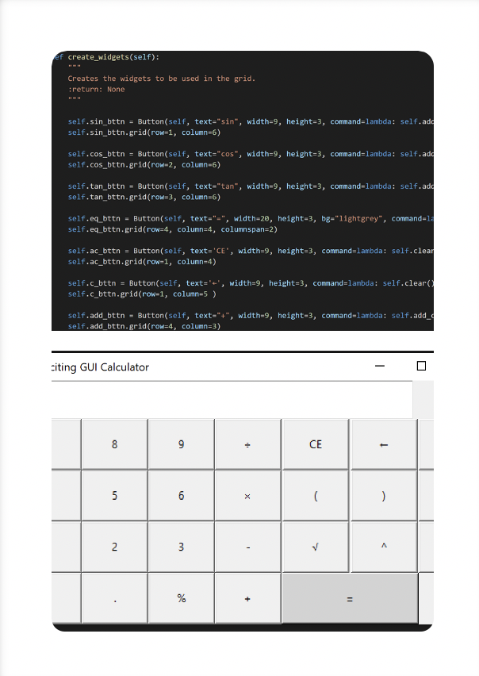
Thank you!

